Slide 1
Interaction Styles

Slide 2
Common interaction styles
command line interface
menus
natural language
question/answer and query dialogue
form-fills and spreadsheets
WIMP
point and click
three–dimensional interfaces

Slide 3
Command Line Interface
Way of expressing instructions to the computer directly
function keys, single characters, short abbreviations, whole words, or a combination
suitable for repetitive tasks
better for expert users than novices
offers direct access to system functionality
command names/abbreviations should be meaningful!
Typical example: the Unix system

Slide 4
Menus
Set of options displayed on the screen
Options visible
less recall - easier to use
rely on recognition so names should be meaningful
Selection by: • numbers, letters, arrow keys, mouse • combination (e.g. mouse plus accelerators) • Often options hierarchically grouped • sensible grouping is needed
Restricted form of full WIMP system

Slide 5
Natural Language
Familiar to user
Speech recognition or typed natural language
Problems
vague
ambiguous
hard to do well!
Solutions
try to understand a subset
pick on key words

Slide 6
Query Interfaces
Question/answer interfaces
user led through interaction via series of questions
suitable for novice users but restricted functionality
often used in information systems
Query languages (e.g. SQL)
used to retrieve information from database
requires understanding of database structure and language syntax, hence requires some expertise

Slide 7
Form Fills
Primarily for data entry or data retrieval
Screen like paper form.
Data put in relevant place
Requires
good design
obvious correction facilities

Slide 8
Spreadsheets
1-2-3MS Excel most common today
sophisticated variation of form-filling.
grid of cells contain a value or a formula
formula can involve values of other cells e.g. sum of all cells in this column
user can enter and alter data spreadsheet maintains consistency

Slide 9
WIMP Interfaces
Windows • Icons • Menus • Pointers • … or windows, icons, mice, and pull-down menus!
default style for majority of interactive computer systems, especially PCs and desktop machines

Slide 10
Point and Click Interfaces
used in ..
multimedia
web browsers
hypertext
just click something!
icons, text links or location on map
minimal typing

Slide 11
Three dimensional Interfaces
virtual reality
‘ordinary’ window systems
highlighting
visual affordance
indiscriminate usejust confusing!
3D workspaces
use for extra virtual space

Slide 12
Speech–driven interfaces
rapidly improving … … but still inaccurate
how to have robust dialogue? … interaction of course!
can’t always avoid errors … … but we can put them right
make it easy to detect errors … then the user can repair them

Slide 13
Physical design
many constraints:
ergonomic – minimum button size
physical – high-voltage switches are big
legal and safety – high cooker controls
context and environment – easy to clean
aesthetic – must look good
economic – … and not cost too much!

Slide 14
Fluidity
do external physical aspects reflect logical effect?
related to affordance
logical state revealed in physical state?
e.g. on/off buttons
inverse actions inverse effects?
e.g. arrow buttons, twist controls

Slide 15
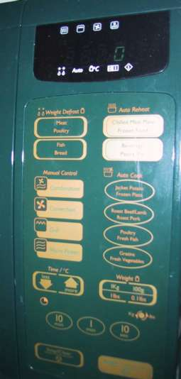
physical layout
controls:
logical relationship ~ spatial grouping

Slide 16
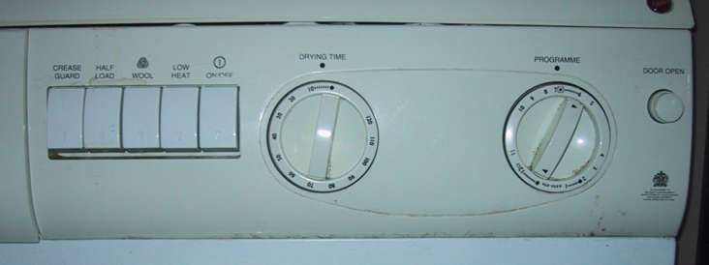
compliant interaction
state evident in mechanical buttons
rotary knobs reveal internal state and can be controlled by both user and machine

Slide 17
General lesson …
if you want someone to do something …
make it easy for them!
understand their values

